Slide 1

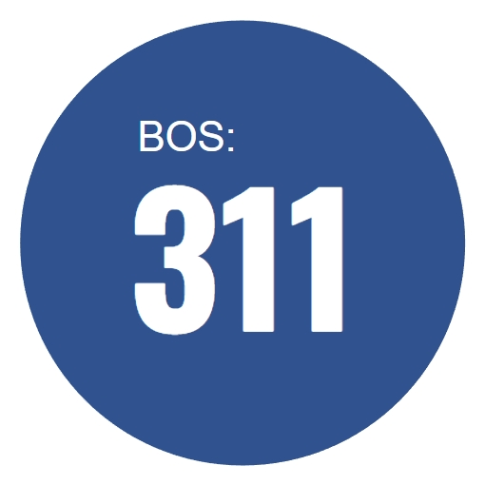
ALY6980 – Capstone Project Presentation
Boston 311 Syringe Request Dashboard
Prof. Roy Wada
Group 8: Shengyao Xu, Akshay Ganesh Hanchate,
Vidhi Rajeshbhai Mistry & Hrithick Gokul Yeddula
03/20/2025

Slide 2
INTRODUCTION
Boston 311 Syringe Request Dashboard
The opioid crisis is a major public health concern in Boston. This project analyzes data from Boston’s 311 service requests to track syringe disposal requests. Our goal is to provide insights for better resource allocation and harm reduction strategies.
Key Objectives:
Identify high-risk areas with frequent syringe disposal requests.
Use data-driven approaches to improve public health responses.
Apply predictive modeling to forecast future trends and guide policy decisions.
By leveraging advanced analytics and Power BI dashboards, we aim to support evidence-based decision-making for safer communities.

Slide 3
Methods
Manual Data Download
Work Flow of
311 Syringe Request
Dashboard Project
Data Cleaning
for EDA
Exploratory Data
Analysis
Auto API Data Download
Data Aggregation
for Power BI
Power BI Dashboard

Slide 4
Data sources
Primary Datasets
1. Boston 311 Service Requests Dataset (Boston.gov, 2023)
Additional Spatial Datasets
2. Boston Property Parcels Dataset (Boston Planning & Development Agency, 2023)
3. Massachusetts ZIP Code Boundaries (MassGIS, 2023)
4. Boston City Council Districts (Boston.gov, 2023)
5. Boston Public Schools Dataset (Boston.gov, 2023a)
6. Boston Non-Public Schools Dataset (Boston.gov, 2023b)
7. Boston Open Spaces Dataset (Boston.gov, 2023c)

Slide 5
Methods
Manual Data Download
1. Standardized column names
2. Removed useless columns and fixed missing values
3. Used the "Needle Program" keyword to filter the data
4. Used City Council Shapefiles to fix city_council_district column
5. Performed Spatial Matching to add owner_name features
6. Determine if Syringe Requests are within 50 meters of the areas
Data Cleaning
for EDA
Exploratory Data
Analysis
Auto API Data Download
Data Aggregation
for Power BI
Power BI Dashboard

Slide 6
Methods
Manual Data Download
1. Based on the data in 2024
2. City Council District Grouping and Summary Table
3. Distribution of Response Time for Needle Reports
Data Cleaning
for EDA
Exploratory Data
Analysis
Auto API Data Download
Data Aggregation
for Power BI
Power BI Dashboard

Slide 7
Methods
Manual Data Download
4. Map of Syringe Requests, Public Schools, Non-public Schools, and Open Spaces
5. Time Trend Analysis and Forecasting
6. K-Means Clustering Analysis of Syringe Requests
Data Cleaning
for EDA
Exploratory Data
Analysis
Auto API Data Download
Data Aggregation
for Power BI
Power BI Dashboard

Slide 8
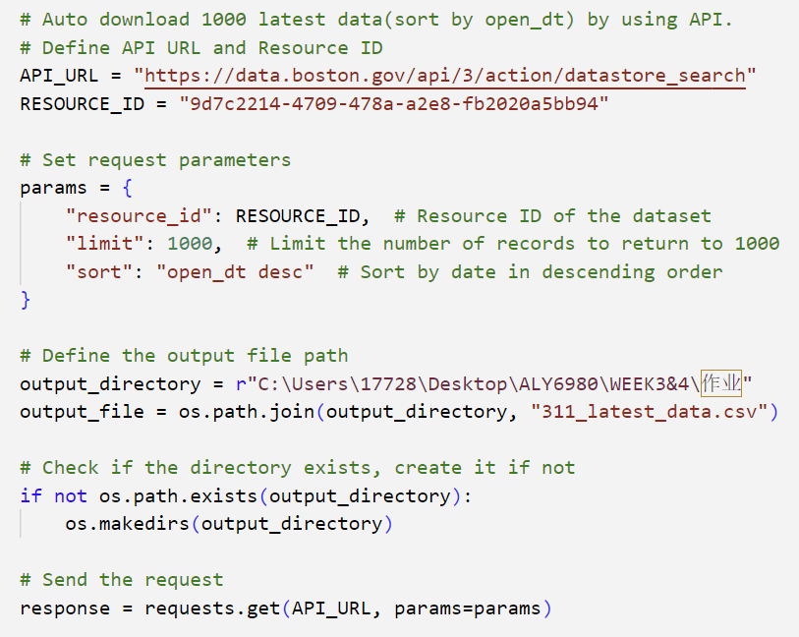
Methods
Manual Data Download
1. Real-Time API Query
(Latest 1000 Records)
Data Cleaning
for EDA
Exploratory Data
Analysis
Auto API Data Download
Data Aggregation
for Power BI
Power BI Dashboard

Slide 9
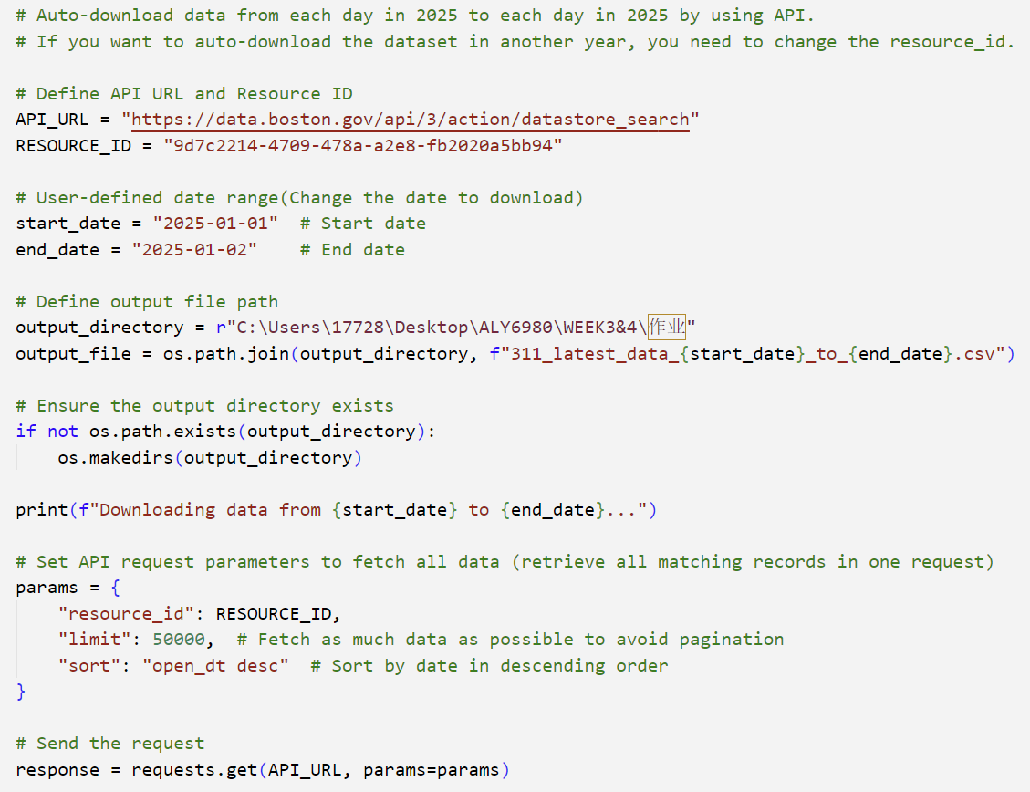
Methods
Manual Data Download
2. Batch API Download
(Daily Data for a Time Range)
Data Cleaning
for EDA
Exploratory Data
Analysis
Auto API Data Download
Data Aggregation
for Power BI
Power BI Dashboard

Slide 10
Methods
Manual Data Download
1. Covered the Data from 2021 to 2025
2. Adjust the data format for Power BI
3. Aggregated the Datasets, and exporting them to CSV files
Data Cleaning
for EDA
Exploratory Data
Analysis
Auto API Data Download
Data Aggregation for Power BI
Power BI Dashboard

Slide 11
Methods
Manual Data Download
1. Imported the dataset and made functions for different KPIs
2. Created several functional areas
3. Designed the Power BI UI
Data Cleaning
for EDA
Exploratory Data
Analysis
Auto API Data Download
Overview of Dashboard:
Data Aggregation
for Power BI
https://app.powerbi.com/links/YyIsLznIq1?ctid=a8eec281-aaa3-4dae-ac9b-9a398b9215e7&pbi_source=linkShare&bookmarkGuid=220104ac-302d-4398-a9e6-da34e27b8854
Power BI Dashboard

Slide 12
Predictive Models
Utilized advanced analytics techniques to identify high-risk neighborhoods and predict future trends in service requests, enabling targeted interventions.
K-Means Clustering
Purpose: Identify distinct clusters of neighborhoods based on risk factors such as crime rates, emergency calls, and socio-economic indicators.
Process: Apply the K-Means clustering algorithm to segment neighborhoods into groups. This helps in understanding different risk profiles and tailoring safety measures appropriately.
SARIMA Time-Series Forecasting
Purpose: Predict future trends in community service requests, such as public safety or maintenance needs.
Process: Develop a SARIMA (Seasonal AutoRegressive Integrated Moving Average) model to forecast the volume of requests. This model considers both seasonal variations and underlying trends, providing a robust prediction mechanism.

Slide 13
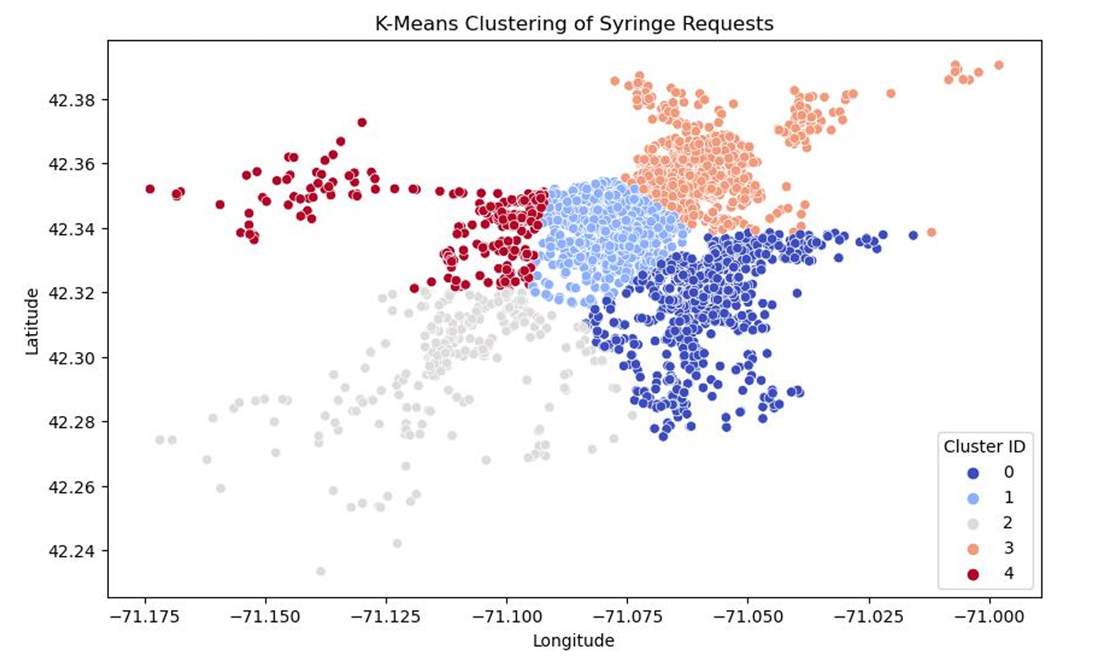
K-Means Clustering
This map uses K-Means machine learning to segment syringe disposal requests into five clusters, with each color indicating a different group of similar locations.
Clusters show varied concentrations: dense clusters indicate hotspots, border zones suggest transitional areas needing more services, and distant clusters highlight isolated cases for targeted interventions.
This analysis aids in resource allocation by prioritizing high-need zones for syringe disposal, informing policy on bin placement and outreach, and guiding public health strategies for effective harm reduction.
Next steps include increasing disposal stations in high-density areas, monitoring cluster trends for shifts or growth, and leveraging this analysis for public health planning and harm reduction efforts.

Slide 14
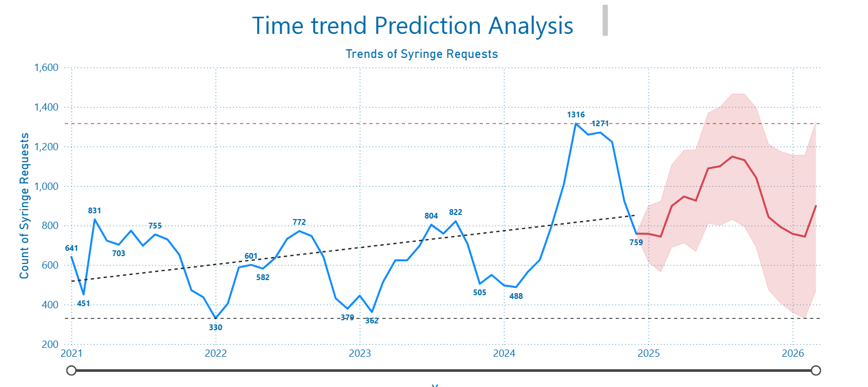
SARIMA Time-Series Forecasting
The blue line shows actual monthly syringe requests, while the red dashed line forecasts future requests using SARIMA modeling.
Historical data reveals seasonal trends in syringe requests, with forecasts predicting increased disposal needs and sharp growth in demand for future months.
This analysis enables proactive planning, optimal resource allocation, and policy impact assessment, helping city officials prepare for and respond to changing syringe disposal needs.
Next steps include scaling up disposal services to meet rising demand, monitoring the impact of policy changes on trends, and using forecasts to shape long-term harm reduction strategies.

Slide 15
List of Policies for Suggestions & Project Outcomes
Suggested Policy Improvements (With Time & Cost Considerations):
Strategic Placement of Disposal Bins – Install more syringe disposal stations in high-risk areas to reduce public health risks. (Time-Saving, Economical)
Real-time Monitoring & Alerts – Implement an automated system that flags increasing syringe disposal trends for quicker response. (Time-Saving, High-Cost)
Public Awareness Campaigns – Launch city-wide educational programs on safe syringe disposal and harm reduction practices. (Time-Consuming, Economical)
Collaboration with Health Agencies – Strengthen partnerships with local health organizations to enhance intervention and outreach efforts. (Time-Saving, Economical)
Community-Based Harm Reduction Services – Establish mobile health units providing on-site support, including clean syringe exchange programs and medical assistance. (Time-Consuming, High-Cost)
This classification helps in understanding the feasibility of each policy in terms of implementation speed and budget requirements.

Slide 16
List of Policies for Suggestions & Project Outcomes
Project Outcomes:
High-Risk Area Identification – Our models pinpoint locations with the most urgent need for intervention.
Predictive Analytics for Policy Making – SARIMA forecasting helps city officials plan ahead for rising syringe disposal demands.
Data-Driven Decision Making – Our dashboard provides real-time insights to inform proactive public health strategies.
Long-Term Public Health Impact – By integrating harm reduction efforts with rehabilitation services, we address both immediate concerns and long-term solutions.
These policies ensure a comprehensive approach—focusing not only on safe disposal but also on preventing substance abuse and supporting recovery efforts.

Slide 17
Conclusion
This project demonstrates how data-driven insights can enhance public health strategies. By analyzing syringe request data, we have identified patterns and trends that help allocate resources efficiently.
Key Takeaways:
Seasonal Trends: Syringe requests increase at specific times of the year.
High-Risk Areas: Considering data from 2021 up to now, District 3 (Dorchester) & 7 (Roxbury) reports the highest number of requests (~33%).
Predictive Modeling: Our SARIMA model forecasts rising demand, allowing proactive responses.
Final Thoughts:
Our research highlights the importance of integrating data analytics in public health planning. By acting on these insights, city officials and healthcare providers can improve safety, reduce harm, and make Boston a healthier place for all.

Slide 18
References
Boston.gov. (2023). 311 Service Requests Dataset. Retrieved from https://data.boston.gov/dataset/311-service-requests
Boston.gov. (2023a). Public Schools Dataset. Retrieved from https://data.boston.gov/dataset/public-schools
Boston.gov. (2023b). Non-Public Schools Dataset. Retrieved from https://data.boston.gov/dataset/non-public-schools
Boston.gov. (2023c). Open Spaces Dataset. Retrieved from https://data.boston.gov/dataset/open-space
Boston Planning & Development Agency. (2023). Boston Property Parcels Dataset. Retrieved from https://boston.maps.arcgis.com/home/item.html?id=1b8f68085e614f598bb581c7558c8e5e

Slide 19
Thank You!
We are open for questions.
Group 8
Shengyao Xu - xu.shengy@northeastern.edu
Akshay Ganesh Hanchate - hanchate.ak@northeastern.edu
Vidhi Rajeshbhai Mistry - mistry.vi@northeastern.edu
Hrithick Gokul Yeddula - yeddula.hr@northeastern.edu

